Slide 1
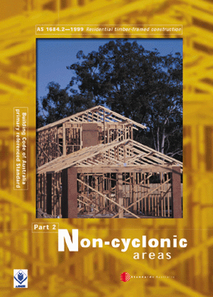
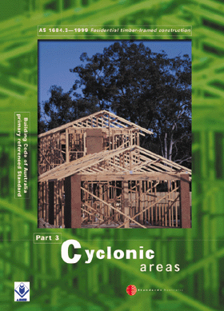
SECTION 2 -
TERMINOLOGY AND GENERAL

Slide 2
2.1 GENERAL
The terminology and definitions given in this Section shall be used in conjunction with the requirements of this Standard.
The terminology used by the building industry varies greatly between states, regions within states and even between those working in the same region. Where possible, the more commonly used terms have been adopted by this standard.

Slide 3
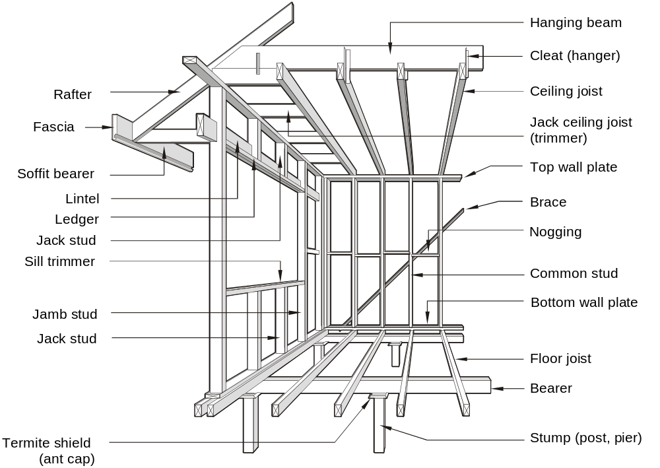
FIGURE 2.1 FRAMING MEMBERS — FLOOR, WALL AND CEILING

Slide 4
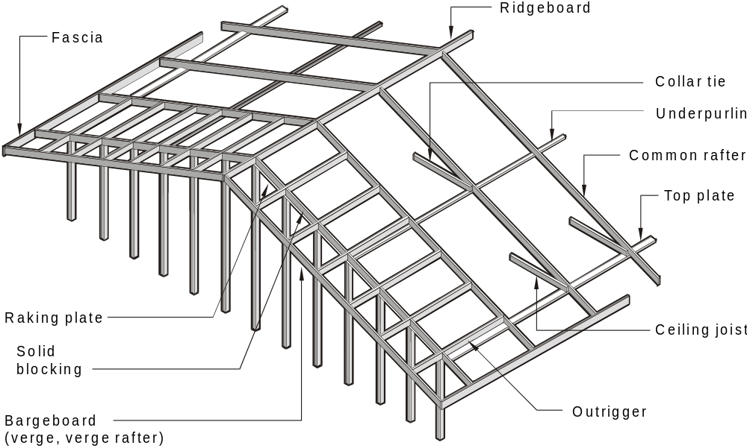
FIGURE 2.2 FRAMING MEMBERS — GABLE ROOF CONSTRUCTION

Slide 5
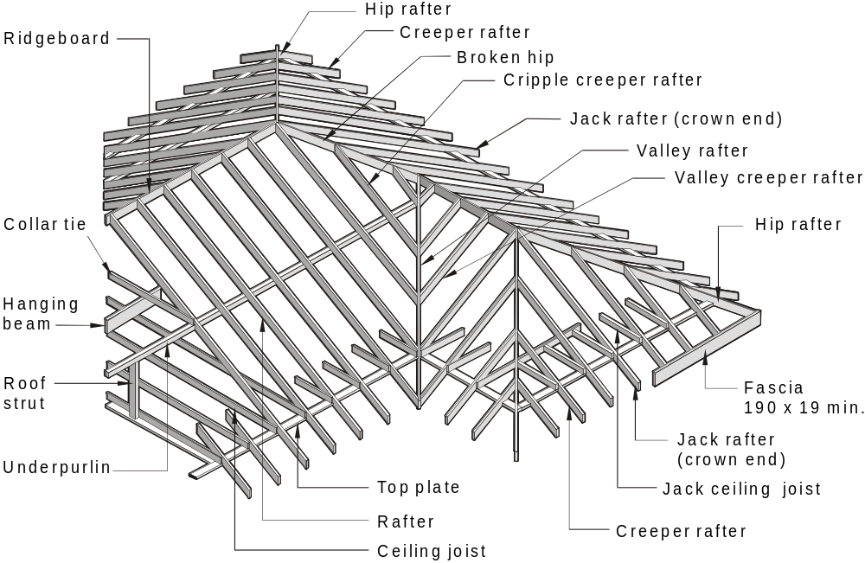
  FIGURE 2.3 FRAMING MEMBERS — HIP AND VALLEY ROOF CONSTRUCTION

Slide 6
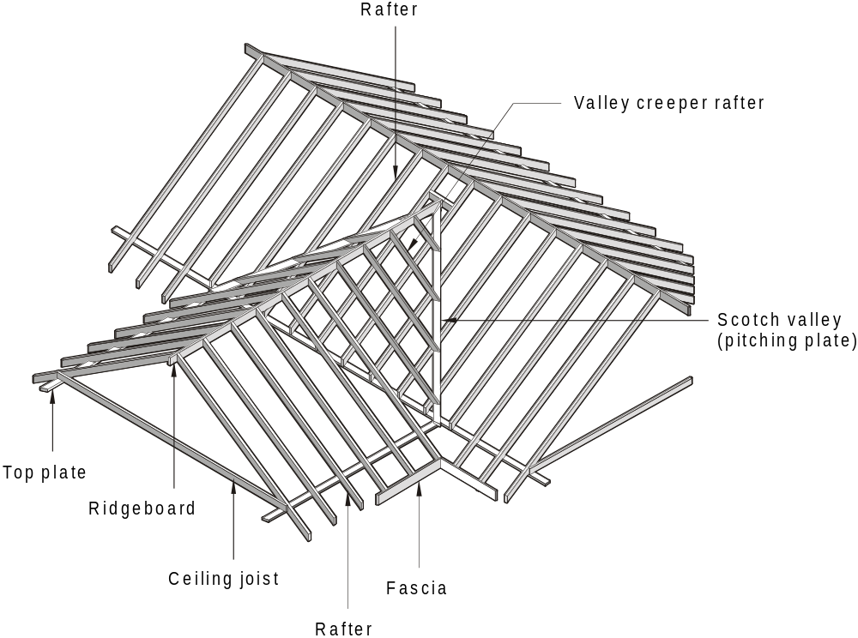
  FIGURE 2.4 FRAMING MEMBERS — SCOTCH VALLEY CONSTRUCTION

Slide 7
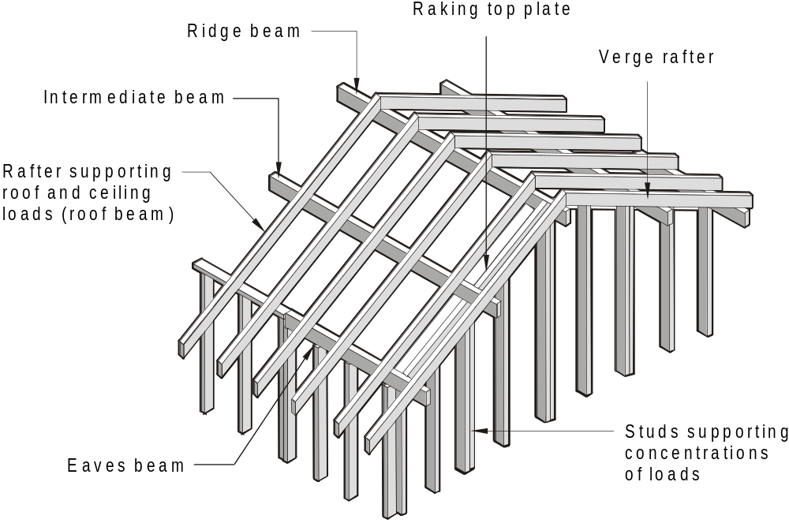
  FIGURE 2.5 FRAMING MEMBERS — CATHEDRAL ROOF CONSTRUCTION

Slide 8
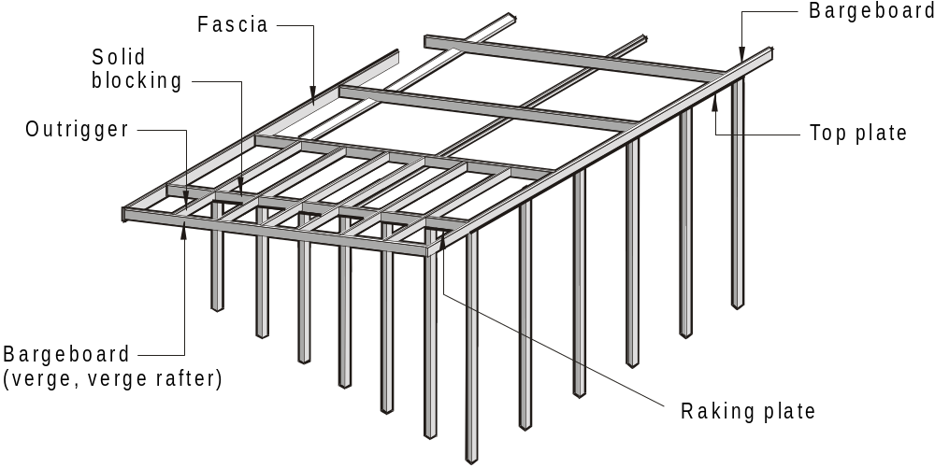
  FIGURE 2.6 SKILLION ROOF

Slide 9
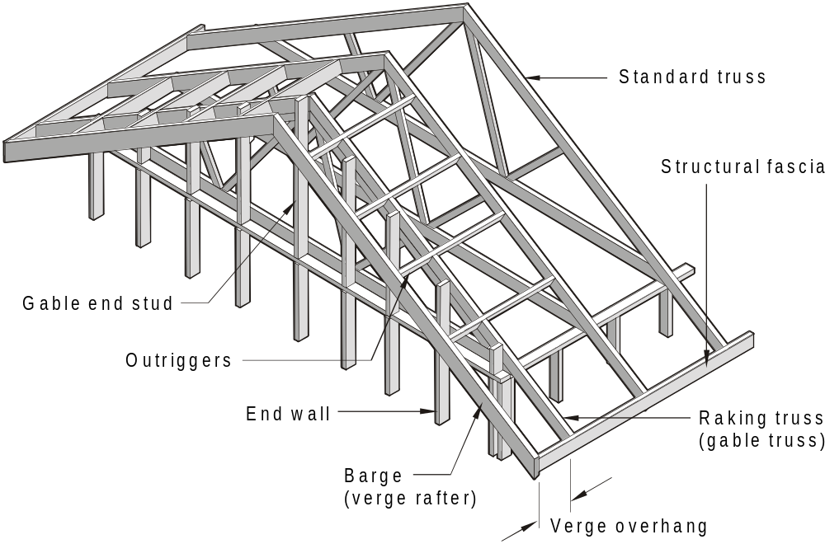
  FIGURE 2.7 GABLE END — TRUSSED ROOF

Slide 10
2.3 VERTICAL NAIL LAMINATION
Vertical nail lamination shall be permitted to achieve the required breadth for larger section sizes given in the Span Tables in the Supplements using thinner and more readily obtainable sections.
This is only permissible using seasoned timber laminations of the same timber type (e.g. hardwood + hardwood, softwood + softwood) and stress grade.

Slide 11
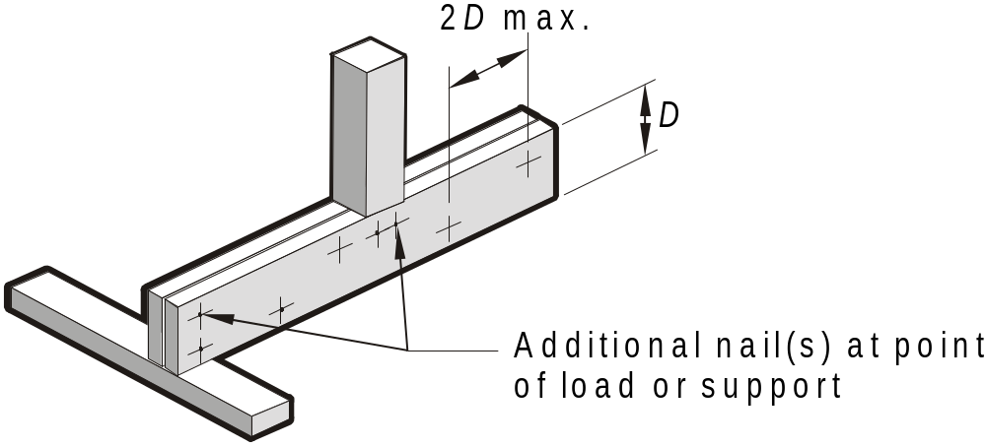
2.3 VERTICAL NAIL LAMINATION
Laminations are to be unjoined in their length. Nails shall be a minimum of 2.8 mm diameter and shall be staggered as shown and through nailed and clinched, or nailed from both sides
No. 10 screws can be used at the same spacing and pattern, provided that they penetrate a minimum of 75% into the thickness of the final receiving member.
FIGURE 2.8 VERTICAL NAIL LAMINATION

Slide 12
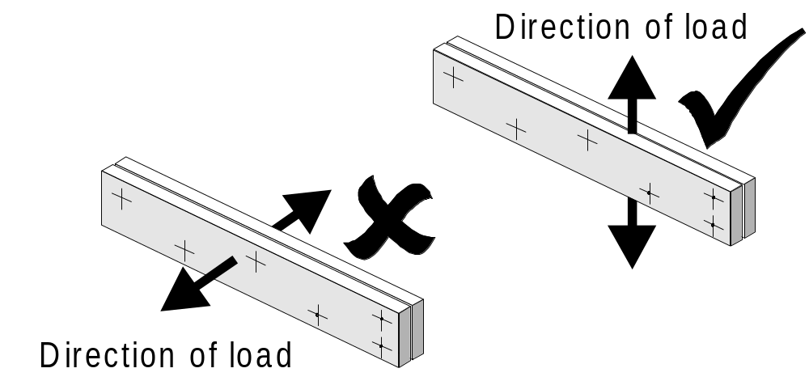
The term 'vertical nail lamination' is used because the loads applied to a house frame are predominantly vertical.
The load applied to nail laminated timber must always be in the direction of the depth of the timber and at 90^{O} to the nails.

Slide 13
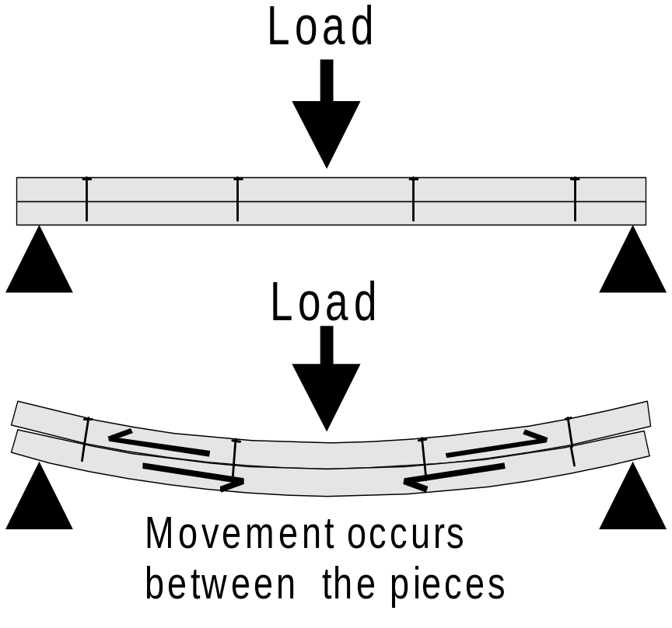
If the load on a nail laminated member is in the opposite direction to the depth and in line with the nails, the nails will be insufficient to prevent movement between the two pieces.
Due to this movement or 'slippage' between the pieces they will act individually rather than as a single member.

Slide 14
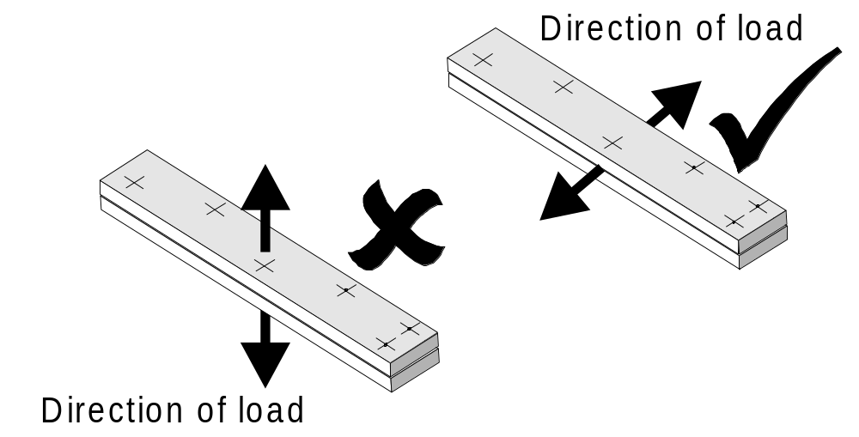
The nail size and spacing that applies to 'vertical nail lamination' is also applicable to members used horizontally where the direction of the applied load is horizontal.

Slide 15

Top and bottom plates are an exception to the rule and can be 'horizontally nail laminated' i.e. with the load in line with the nails. Refer Clause 2.5.
The multiple member sizes given in the Span tables take into consideration the reduced effectiveness of this type of nail lamination

Slide 16
2.4 STUD LAMINATION
The required stud size may be built up using two or more laminations of the same timber type, (e.g. hardwood + hardwood, softwood + softwood) stress grade and moisture content condition (unseasoned and seasoned studs may be nail laminated) providing the achieved width is at least that of the size nominated.

Slide 17
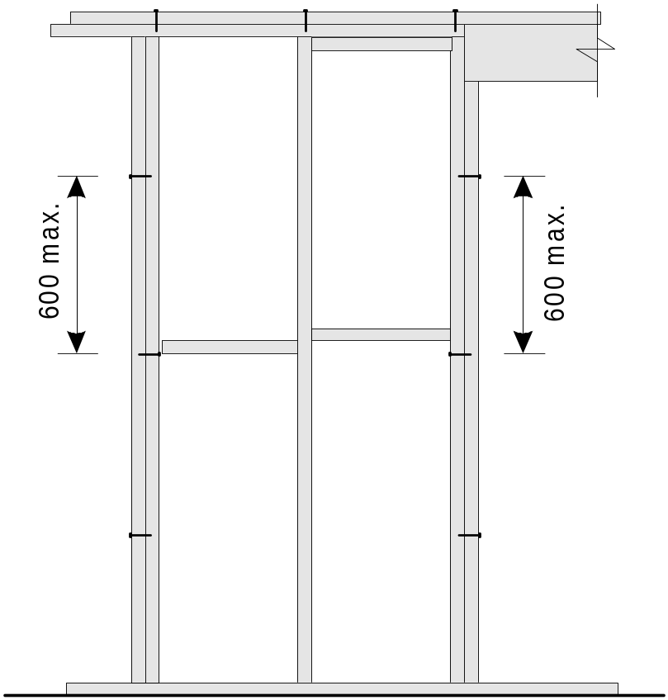
2.4 STUD LAMINATION
Studs up to 38 mm thick shall be nailed together with one 75 mm nail at maximum 600 mm centres. Studs over 38 mm but not exceeding 50 mm thick shall be nailed with one 90 mm nail at maximum 600 mm centres.
No. 10 screws can be used at the same spacing and pattern, provided that they penetrate a minimum of 75% into the thickness of the final receiving member.

Slide 18
2.5 HORIZONTAL NAIL LAMINATION -- WALL PLATES ONLY
Wall plates that are made up of more than one section (e.g. 2/35 × 70) shall be horizontally nail laminated in accordance with Figure 2.9 and using two 75 mm long nails for plates up to 38 mm deep; or two 90 mm long nails for plates up to 50 mm deep …at a maximum of 600 mm centres.

Slide 19
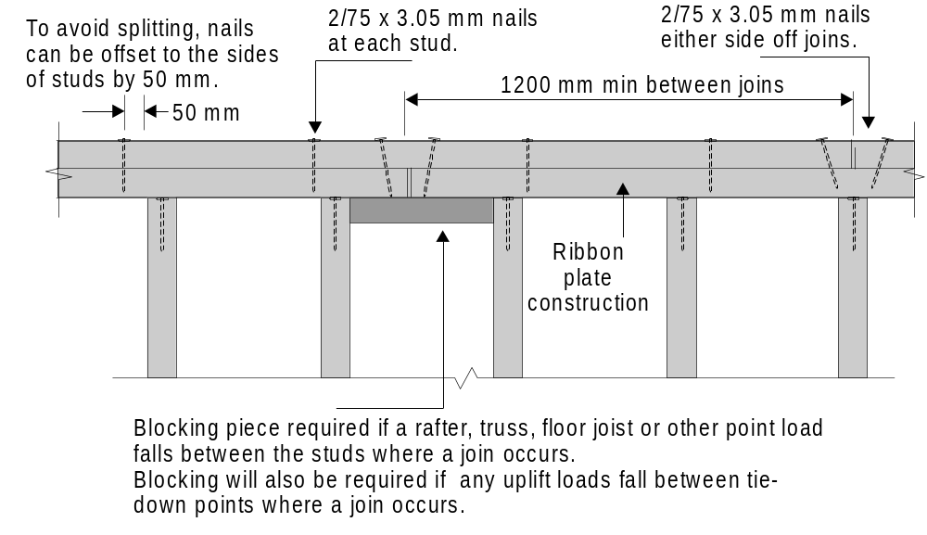

Slide 20
2.6 LOAD WIDTH AND AREA SUPPORTED
To determine a timber size for a particular member, the amount of dead & live load that is to be applied to that member must be determined prior to entering the span tables. The amount of load is directly proportional to the AREA of roof and/or floor that this member supports.
For most members, this AREA is not actually calculated but “Load width, .. plus.. another geometric descriptor such as spacing (or span) will define an area of load that a member is required to support”.

Slide 21
There are some important points to remember about determining load widths and areas supported.

Slide 22
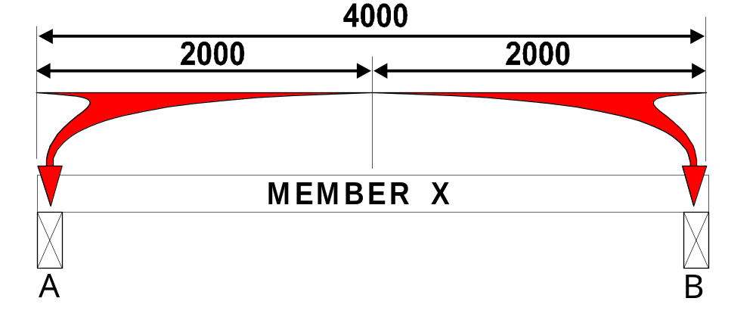

Loads are distributed equally between points of support.
Of the total load on MEMBER X, half (2000mm) will be supported by the beam or wall at A and half (2000mm) will be supported by the beam or wall at B.

Slide 23
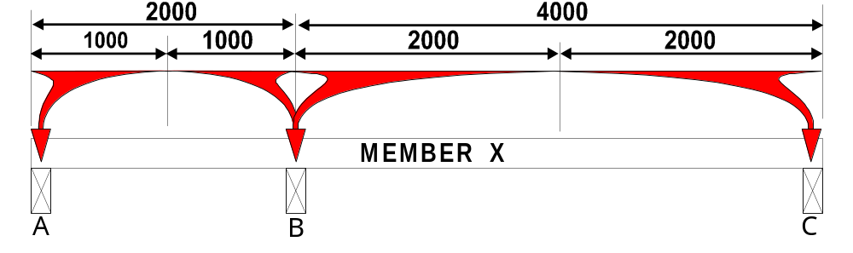
If MEMBER X is supported at 3 or more points, it is assumed that half the load carried by the spans either side of supports will be equally distributed.
Beam A will carry 1000 mm of load, Beam B will carry 1000 mm plus the 2000 mm on the other side, and Beam C will carry 2000 mm.

Slide 24
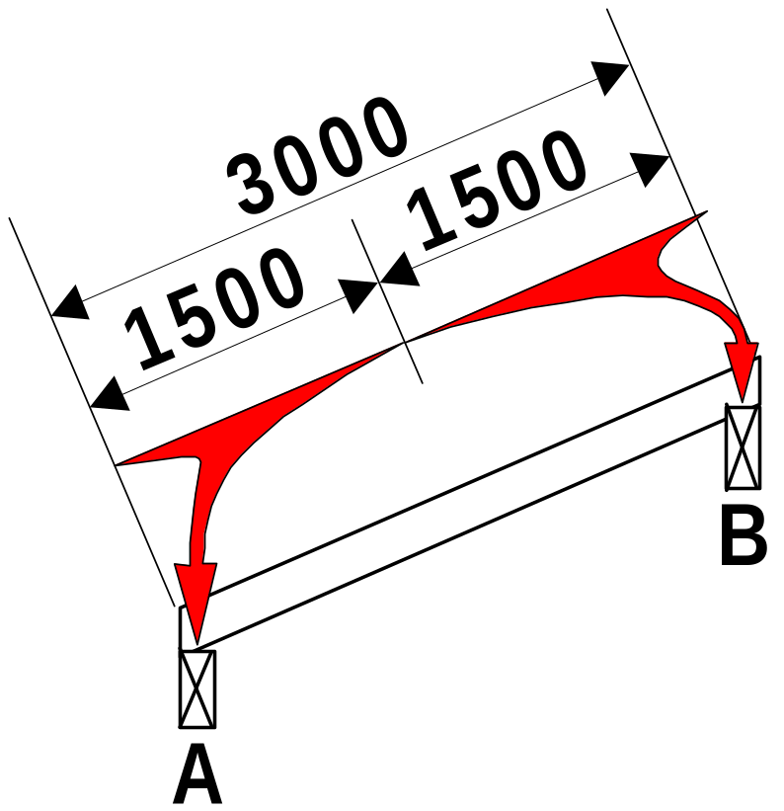

Loads Widths are measured in plane of the roof or floor that imparts load onto supporting members.
Roof Load Widths are measured on the rake of the roof,
Floor and Ceiling Load Widths are measured in the plane of the floor or ceiling which is normally horizontal, however if floor or ceiling joist are on the rake, the measurements are taken on this rake. (For example a ramp may have raking bearers or floor joist.)

Slide 25
2.6.2 Floor load width
Floor load width (FLW) is the contributory width of floor, measured horizontally, that imparts floor load to a supporting member.
FLW shall be used as an input to Span Tables in the Supplements for all bearers and lower storey wall framing members

Slide 26
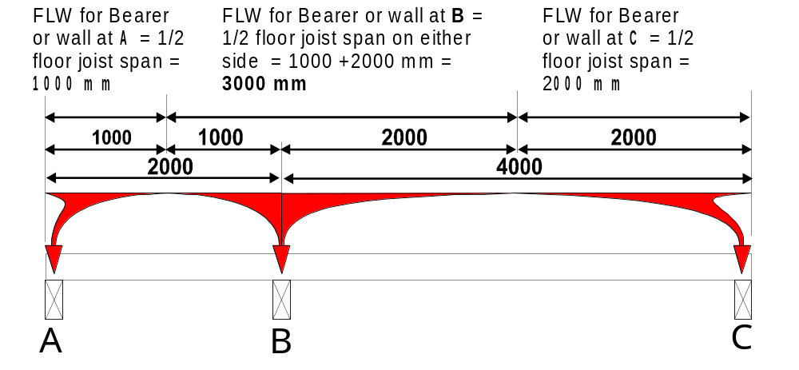
Of the total load on a floor joist, half will go to the bearer on one end and half to the bearer on the other end. So floor load width (FLW) is simply half the floor joist span on either side of the bearer, added together. The only exception is where there is a cantilever. In this situation, the total cantilever distance plus half of the floor joist span is used.

Slide 27
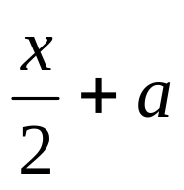
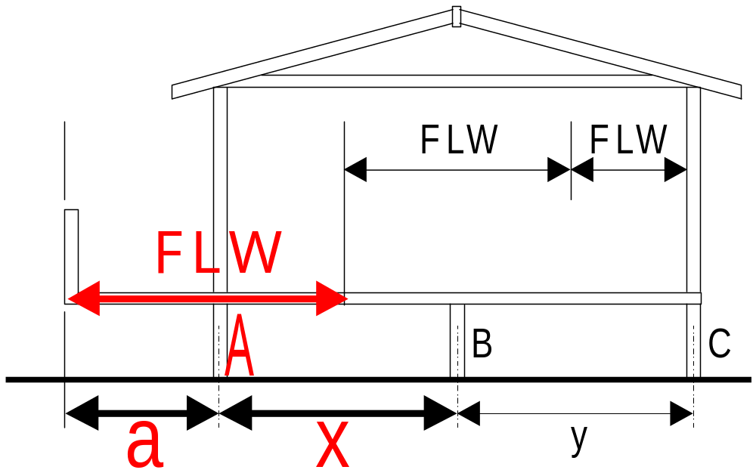
FIGURE 2.10 FLOOR LOAD WIDTH (FLW)
⎯ SINGLE OR UPPER STOREY CONSTRUCTION
(a) Cantilevered balcony
FLW bearer A =

Slide 28
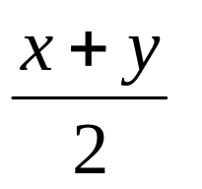
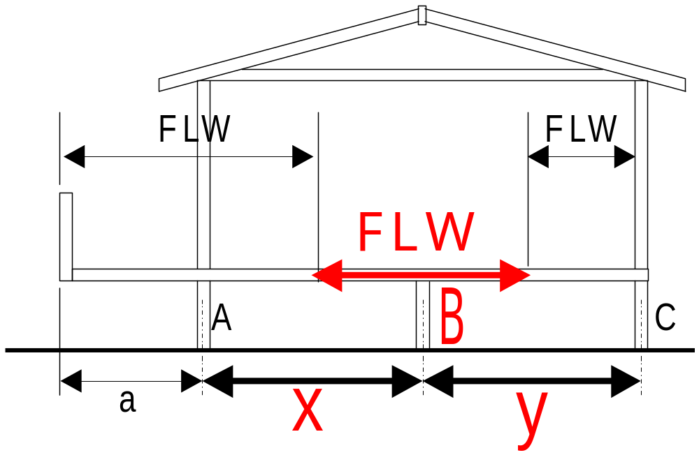
FIGURE 2.10 FLOOR LOAD WIDTH (FLW)
⎯ SINGLE OR UPPER STOREY CONSTRUCTION
(a) Cantilevered balcony
FLW bearer B =

Slide 29

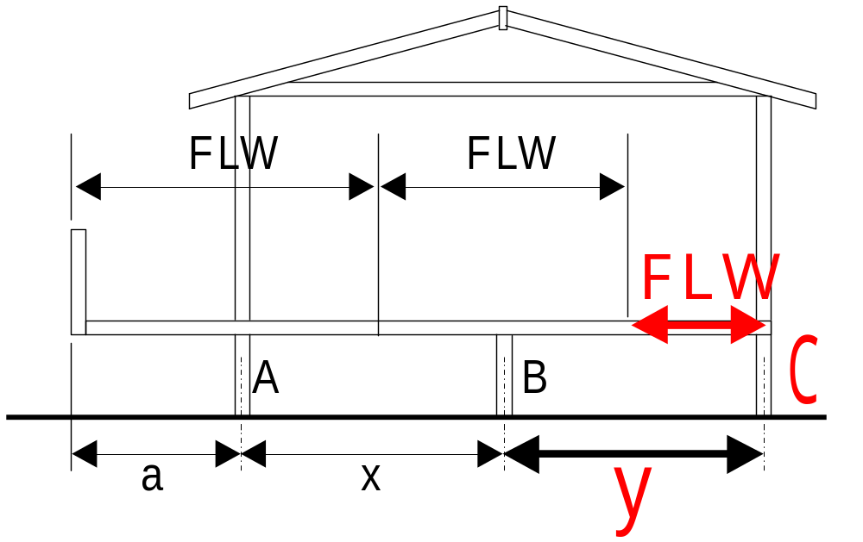
FIGURE 2.10 FLOOR LOAD WIDTH (FLW)
⎯ SINGLE OR UPPER STOREY CONSTRUCTION
(a) Cantilevered balcony
FLW bearer C =

Slide 30
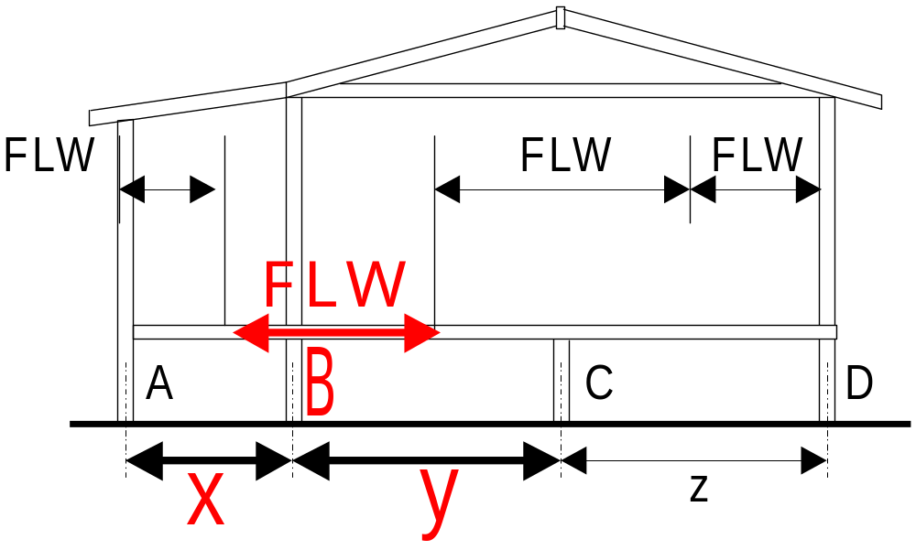
FIGURE 2.10 FLOOR LOAD WIDTH (FLW)
⎯ SINGLE OR UPPER STOREY CONSTRUCTION
(b) Supported balcony
FLW bearer B =

Slide 31
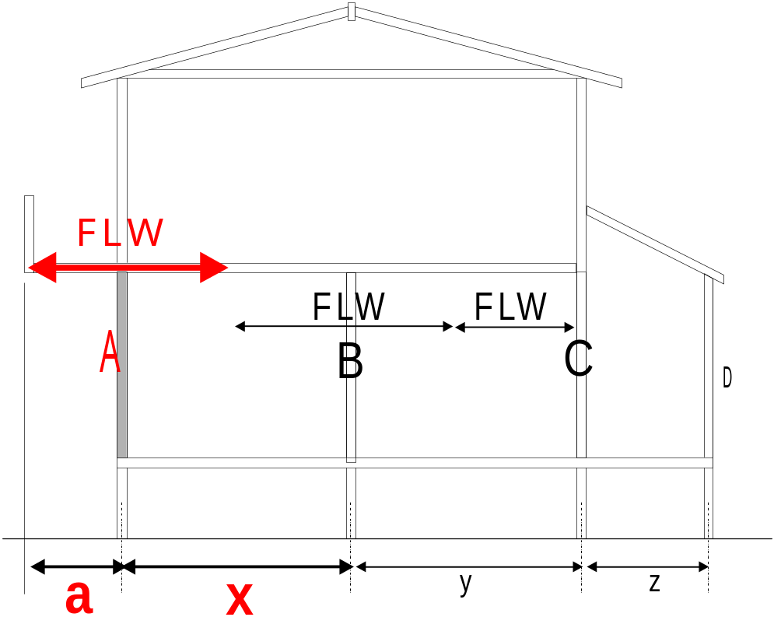
FIGURE 2.11 FLOOR LOAD WIDTH (FLW)
⎯ TWO STOREY CONSTRUCTION
Lower storey loadbearing walls
FLW wall A =

Slide 32
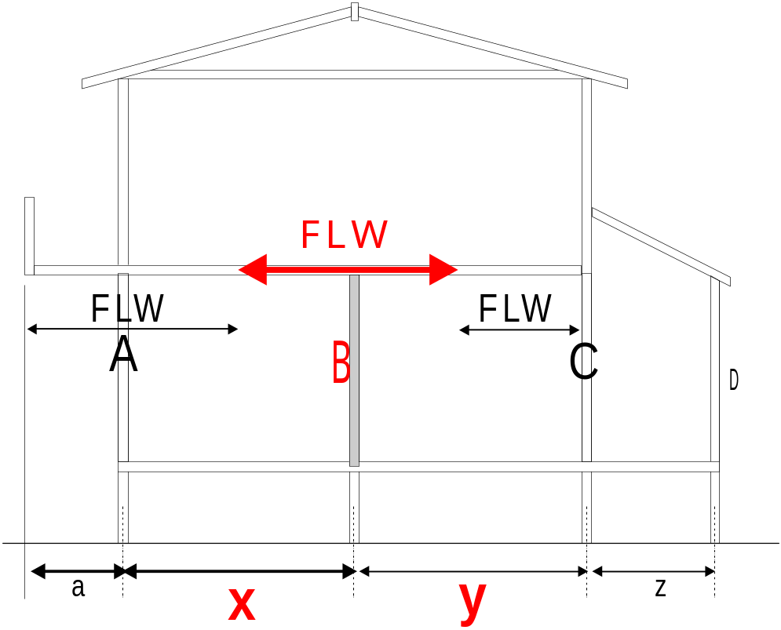
FIGURE 2.11 FLOOR LOAD WIDTH (FLW)
⎯ TWO STOREY CONSTRUCTION
Lower storey loadbearing walls
FLW wall B =

Slide 33
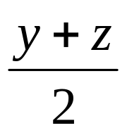
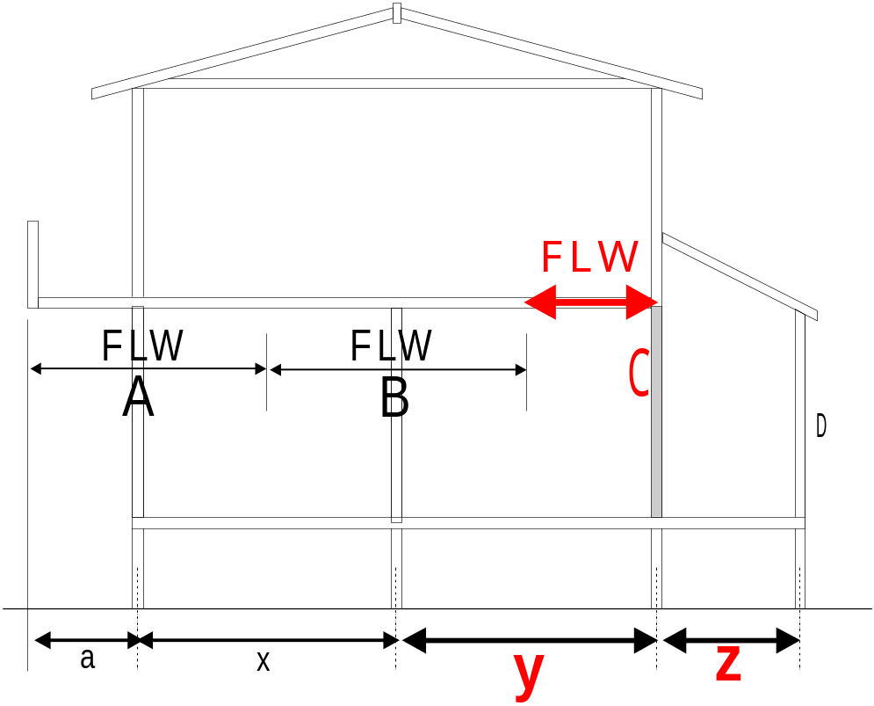
FIGURE 2.11 FLOOR LOAD WIDTH (FLW)
⎯ TWO STOREY CONSTRUCTION
Lower storey loadbearing walls
FLW wall C =

Slide 34
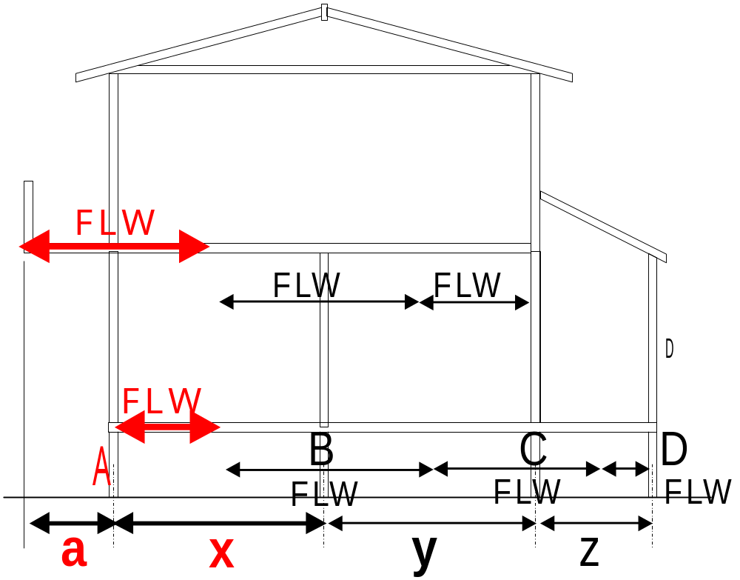

FIGURE 2.11 FLOOR LOAD WIDTH (FLW)
⎯ TWO STOREY CONSTRUCTION con’t
Bearers supporting lower storey loadbearing walls
FLW bearer A =
Upper FLW
+
Lower FLW

Slide 35
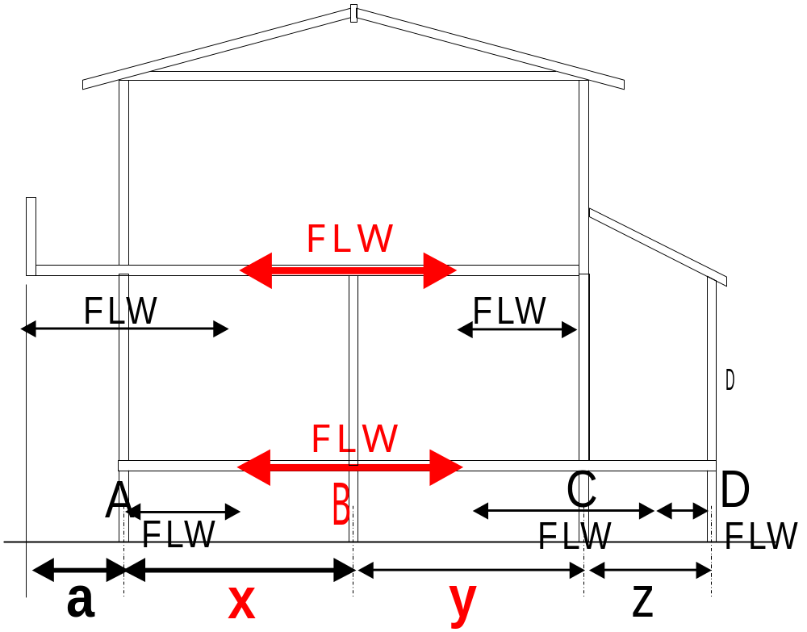
FIGURE 2.11 FLOOR LOAD WIDTH (FLW)
⎯ TWO STOREY CONSTRUCTION con’t
Bearers supporting lower storey loadbearing walls
FLW bearer B =
Upper FLW
+
Lower FLW

Slide 36
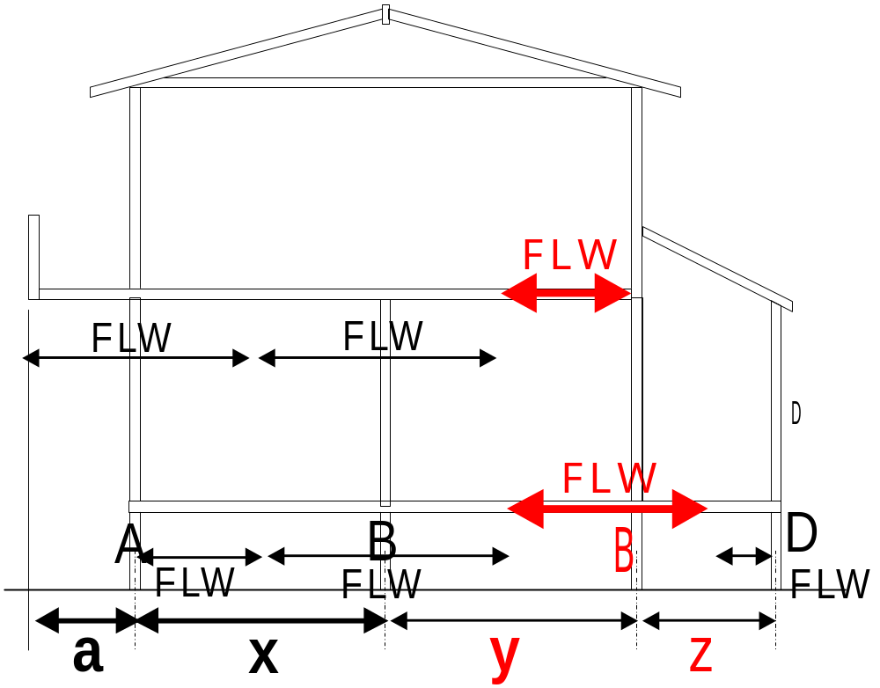
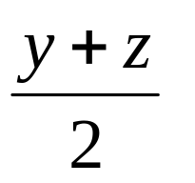
FIGURE 2.11 FLOOR LOAD WIDTH (FLW)
⎯ TWO STOREY CONSTRUCTION con’t
Bearers supporting lower storey loadbearing walls
FLW bearer C =
Upper FLW
+
Lower FLW

Slide 37
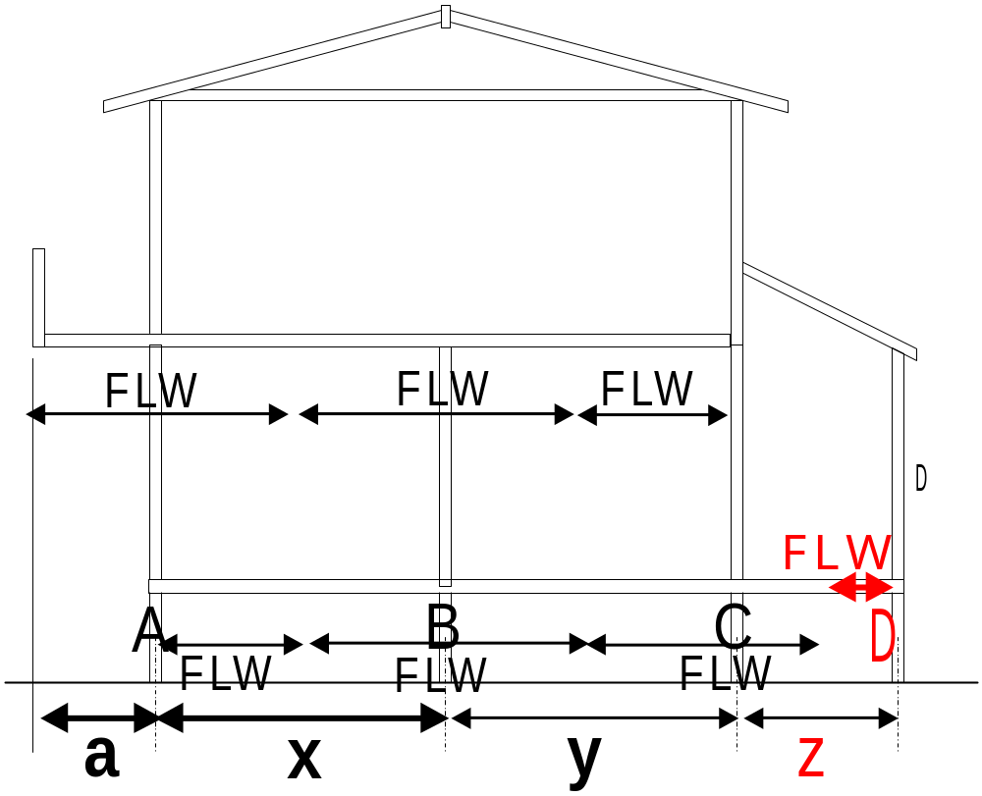

FIGURE 2.11 FLOOR LOAD WIDTH (FLW)
⎯ TWO STOREY CONSTRUCTION con’t
Bearers supporting lower storey loadbearing walls
FLW bearer D =
Lower FLW

Slide 38
2.6.3 Ceiling load width (CLW)
Ceiling load width (CLW) is the contributory width of ceiling, usually measured horizontally, that imparts ceiling load to a supporting member.
CLW shall be used as an input to Span Tables for hanging beams, counter beams and strutting/hanging beams.

Slide 39
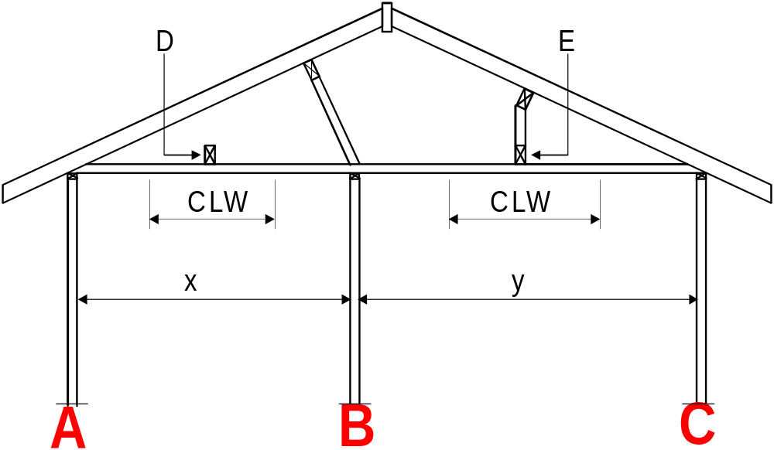
FIGURE 2.12 CEILING LOAD WIDTH (CLW)
Walls A, B & C
* CLW is not required as an input to the Tables for wall framing or bearers supporting loadbearing walls at A, B and C – because these loads are already included in the ‘Sheet’ or ‘Tile’ roof loads required as input to the tables for these members.

Slide 40
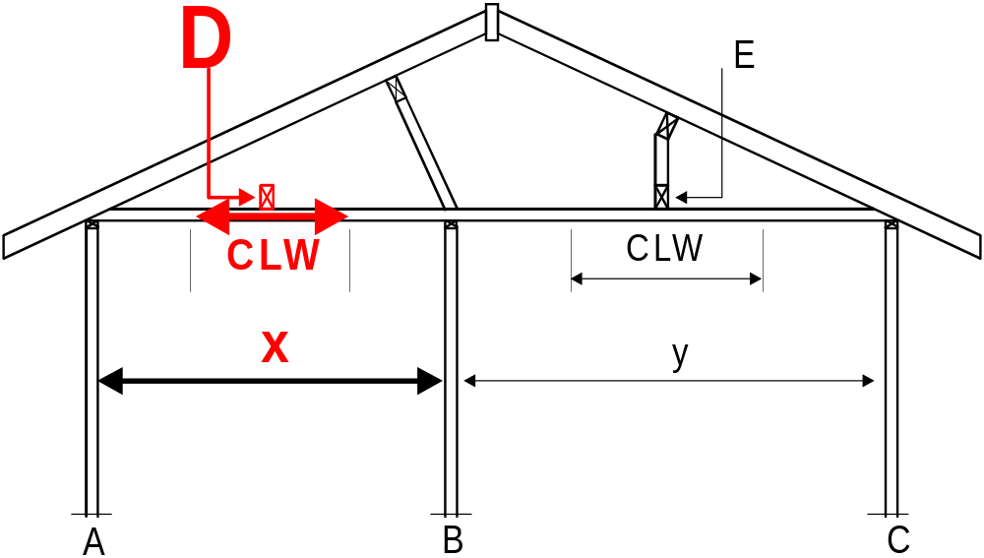
FIGURE 2.12 CEILING LOAD WIDTH (CLW)
CLW Hanging beam D =

Slide 41

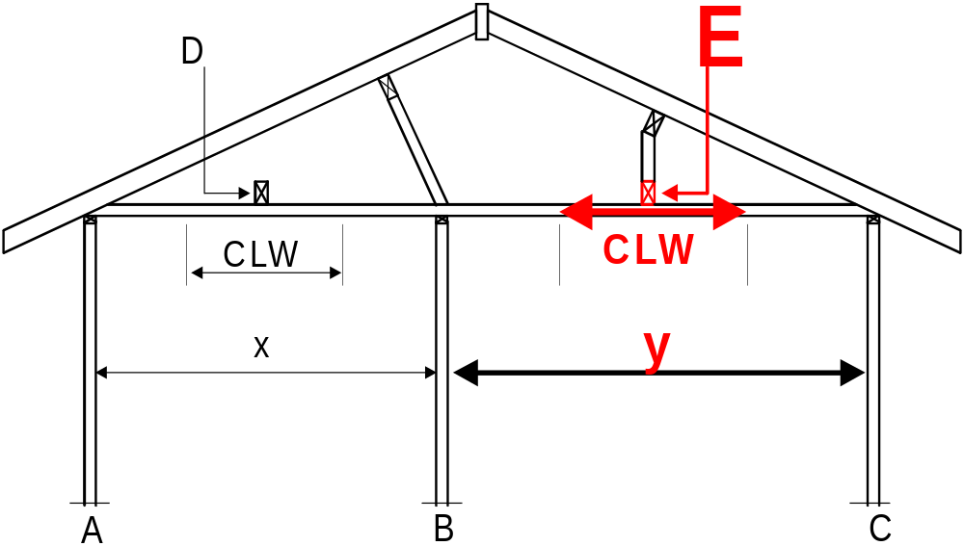
FIGURE 2.12 CEILING LOAD WIDTH (CLW)
CLW Strutting/Hanging beam E =

Slide 42
2.6.4 Roof load width (RLW)
The roof load width (RLW) is used as a convenient indicator of the roof loads that are carried by some roof members and loadbearing wall members and their supporting sub-structure.
The RLW value shall be used as an input to the relevant wall framing and substructure Span Tables

Slide 43
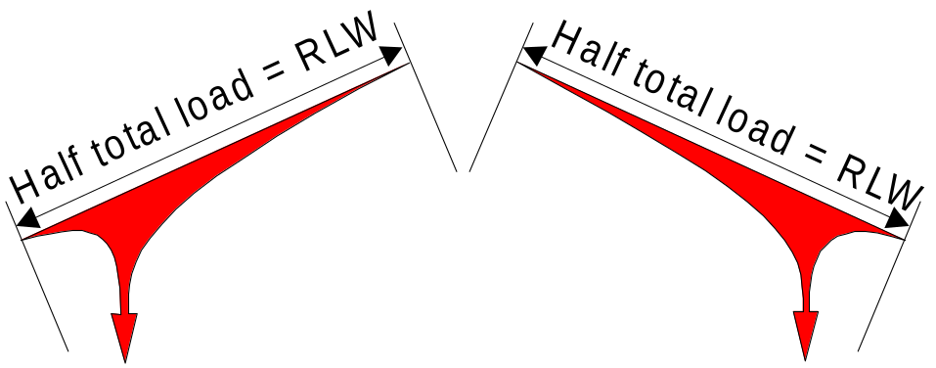
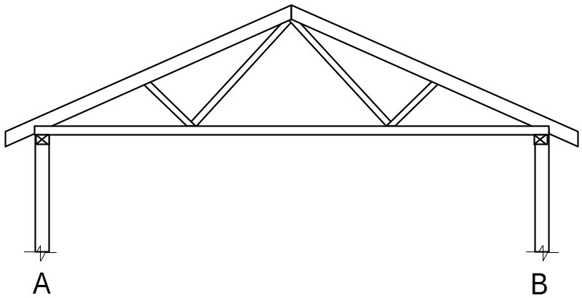
2.6.4 Roof load width (RLW) (cont’d)
Of the roof load on members such as rafters and trusses, half will go to the supporting wall or beam on one end and half to the supporting wall or beam on the other end.
Roof load width (RLW) is simply half the particular member’s span, between support point, plus any overhang, and is measured on the rake of the roof.

Slide 44
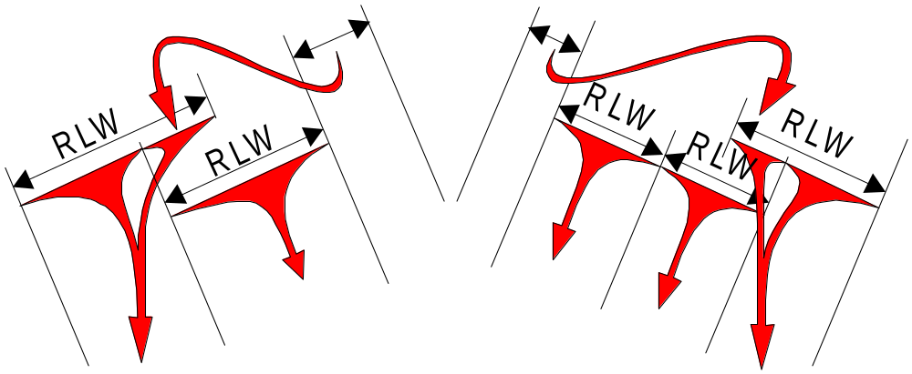
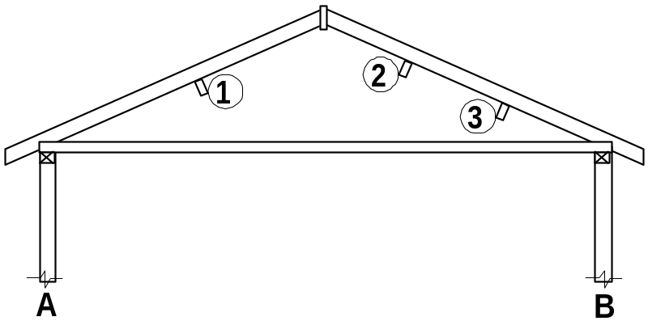
2.6.4 Roof load width (RLW) (cont’d)
The same applies to pitched roofs, however the loads are spread between more support points - walls A, B, the underpurlins and ridge struts (if used).
Although RLW's are not shown in AS1684 for the underpurlins, an equivalent measurement to these RLW's will be required to calculate the area supported for the studs that will support the concentrated loads at the end of struts and/or strutting beams that support the underpurlins.

Slide 45
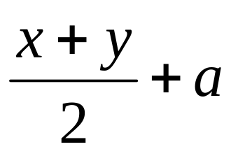
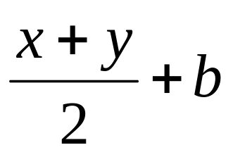
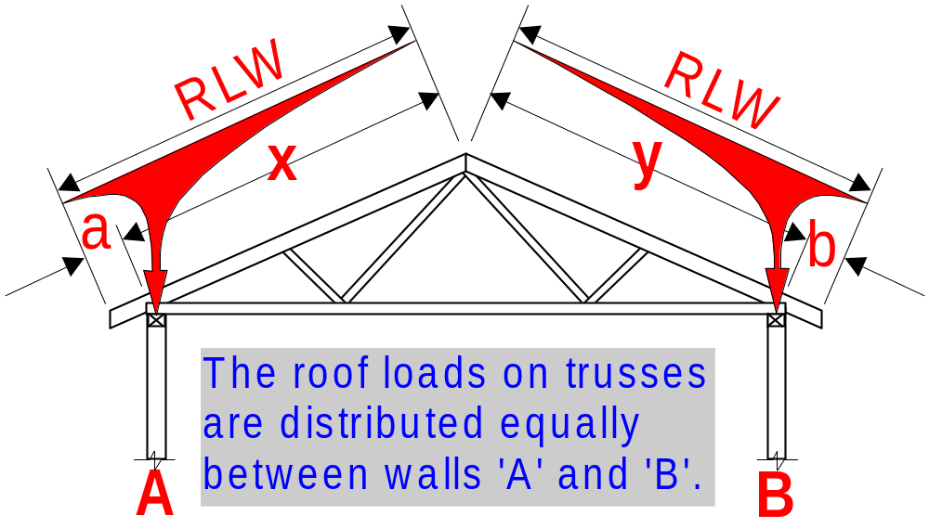
FIGURE 2.13 ROOF LOAD WIDTH (RLW)
(a) Trusses
RLW wall A =
RLW wall A =

Slide 46
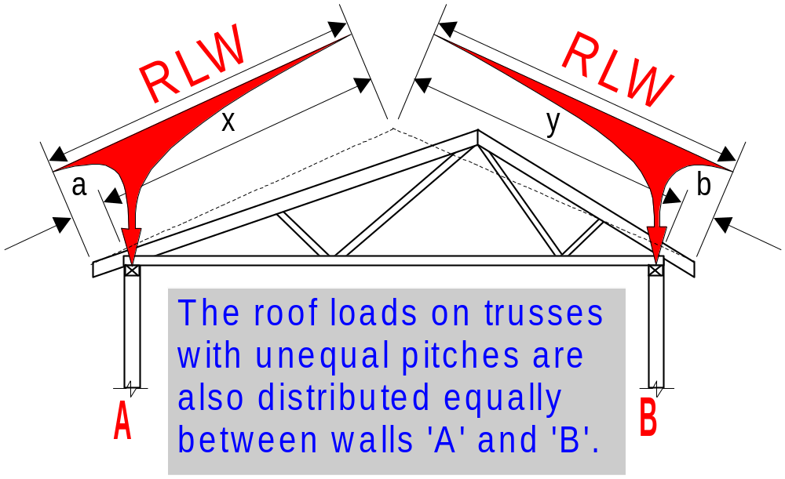
FIGURE 2.13 ROOF LOAD WIDTH (RLW)
(a) Trusses with unequal pitches.
RLW wall A =
RLW wall B =

Slide 47
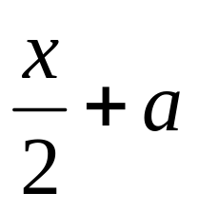
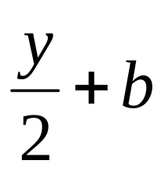
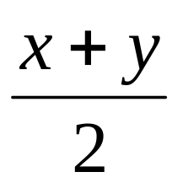
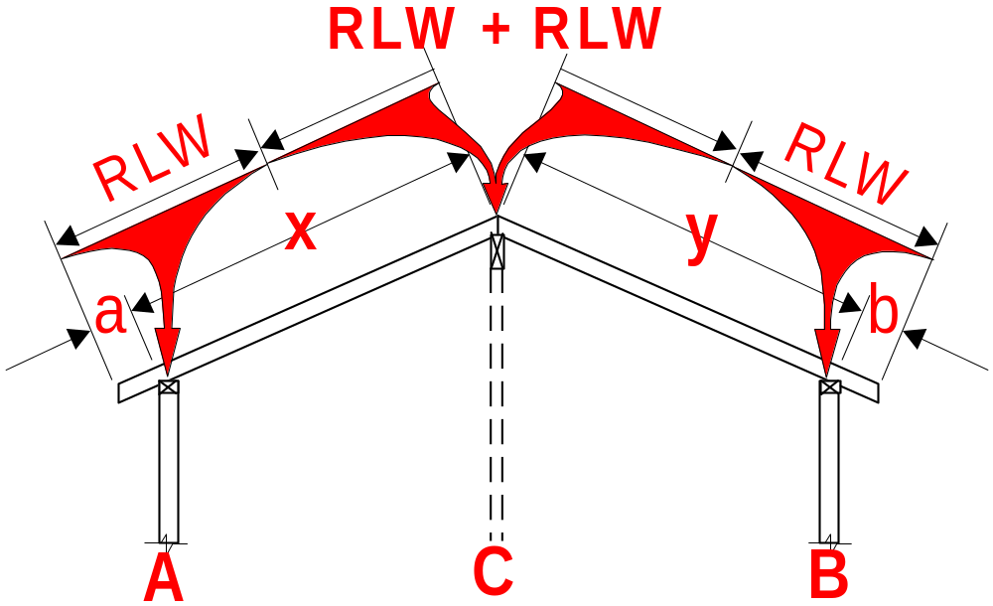
FIGURE 2.13 ROOF LOAD WIDTH (RLW)
(b) Cathedral roof.
RLW wall A =
RLW wall B =
RLW wall C =

Slide 48
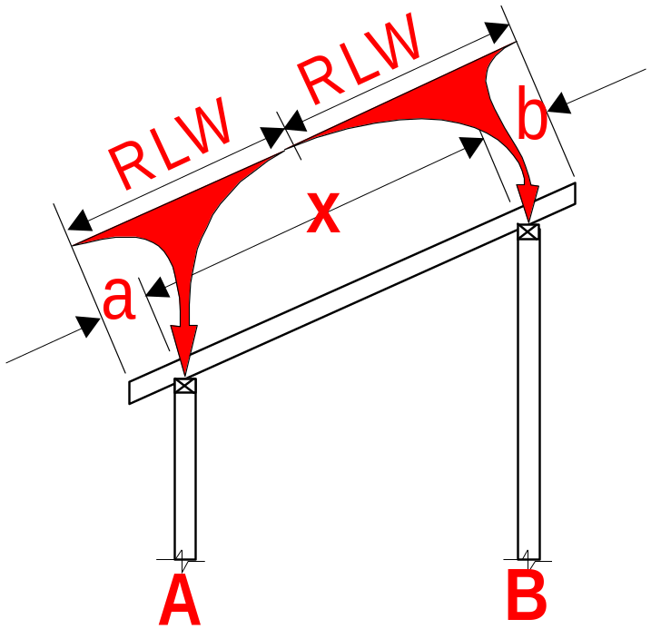
FIGURE 2.13 ROOF LOAD WIDTH (RLW)
(b) Skillion roof.
RLW wall A =
RLW wall B =

Slide 49

FIGURE 2.14 ROOF LOAD WIDTH (RLW)
COUPLED ROOFS WITH NO UNDERPURLINS
(i) No ridge struts
RLW wall A =
RLW wall A =

Slide 50

FIGURE 2.14 ROOF LOAD WIDTH (RLW)
COUPLED ROOFS WITH NO UNDERPURLINS
(ii) With ridge struts
RLW wall A =
RLW wall B =
*RLW wall C =
*Although it states that a RLW is not applicable (N/A) for wall 'C,' a measurement equal to the 'RLW' shown at right and calculated above, will be required to calculate the area supported by the 'studs supporting concentrated loads' in wall 'C'.

Slide 51

FIGURE 2.15 ROOF LOAD WIDTH (RLW)
COUPLED ROOFS WITH UNDERPURLINS
(i) No ridge struts
RLW wall A =
RLW wall B =
*
For a pitched roof without ridge struts, it is assumed that some of the load from the un-supported ridge will travel down the rafer to walls 'A' and 'B'. The RLW's for walls A & B are increased accordingly.

Slide 52



FIGURE 2.15 ROOF LOAD WIDTH (RLW)
COUPLED ROOFS WITH UNDERPURLINS
(i) No ridge struts
Although RLW's are not shown for the underpurlins these RLW's are required by the Underpurlin span table and to calculate the area supported by the ‘studs supporting concentrated loads’ at the end of struts and/or strutting beams that support the underpurlins.
Underpurlin 1 =
Underpurlin 2 =
Underpurlin 3 =

Slide 53




FIGURE 2.15 ROOF LOAD WIDTH (RLW)
COUPLED ROOFS WITH UNDERPURLINS
(ii) With ridge struts
RLW wall A =
RLW wall B =
*RLW wall C =
*
Although it states that a RLW is not applicable (N/A) for wall 'C,' a measurement equal to the 'RLW' shown at right and calculated above, will be required to calculate the area supported by the 'studs supporting concentrated loads' in wall 'C'.

Slide 54

FIGURE 2.15 ROOF LOAD WIDTH (RLW)
COUPLED ROOFS WITH UNDERPURLINS
(i) With ridge struts
Although RLW's are not shown for the underpurlins these RLW's are required by the Underpurlin span table and to calculate the area supported by the ‘studs supporting concentrated loads’ at the end of struts and/or strutting beams that support the underpurlins.
Underpurlin 1 =
Underpurlin 2 =
Underpurlin 3 =

Slide 55

FIGURE 2.16 ROOF LOAD WIDTH (RLW)
COMBINATIONS AND ADDITIONS
(i) Cathedral - Framed (pitched)
RLW wall A =
RLW wall B =
RLW wall C =

Slide 56

FIGURE 2.16 ROOF LOAD WIDTH (RLW)
COMBINATIONS AND ADDITIONS
(i) Cathedral - Framed (pitched)
Although RLW's are not shown for the underpurlins these RLW's are required by the Intermediate Beam and Underpurlin span tables and to calculate the area supported by the ‘studs supporting concentrated loads’ at the end of struts and/or strutting beams that support the underpurlins.
Beam 1 =
Underpurlin 2 =
Underpurlin 3 =

Slide 57

FIGURE 2.16 ROOF LOAD WIDTH (RLW)
COMBINATIONS AND ADDITIONS
(ii) Cathedral - Truss
RLW wall A =
RLW wall B =
RLW wall C =

Slide 58



FIGURE 2.16 ROOF LOAD WIDTH (RLW)
COMBINATIONS AND ADDITIONS
(iii) Verandah
RLW wall A =
RLW wall B =
RLW of Main Roof

Slide 59
2.6.5 Area supported
The area supported by a member is the contributory area, measured in either the roof or floor plane that imparts load onto supporting members.
The area supported by a member is calculated by multiplying together a combination of load widths, spans or spacings.

Slide 60

2.6.5 Area supported - FIGURE 2.17 (a)
EXAMPLE: The STRUTTING BEAM span table (Table 27) requires a ‘Roof Area Supported (m²)’ input.
The strutting beam shown supports a single strut that supports an underpurlin - RIDGE STRUTTED .
A4
The area supported by the strut is calculated as follows:-
A
(1/2)A
B
The sum of, half the underpurlin spans either side of the strut (1/2)A,
(1/2)B
multiplied by the sum of half the rafter spans either side of the underpurlin (1/2)B.
Roof Area Supported =
(1/2) A x (1/2)B

Slide 61
NOTE:
B/2 (the sum of half the rafter spans either side of the underpurlin) is the ‘RLW’ for the underpurlin.
B
B/2

Slide 62
2.6.5 Area supported - FIGURE 2.17 (a) (cont’d)
EXAMPLE: The STRUTTING BEAM span table (Table 27) requires a ‘Roof Area Supported (m²)’ input.
The strutting beam shown supports a single strut that supports an underpurlin - RIDGE NOT STRUTTED
A4
The area supported by the strut is calculated as follows:-
A
(1/2)A
B
The sum of, half the underpurlin spans either side of the strut (1/2)A,
(3/4)B
multiplied by the sum of three quarters of the rafter spans either side of the underpurlin (3/4)B.
Roof Area Supported =
(1/2) A x (3/4)B

Slide 63
NOTE:
(3/4)B (the sum of three quarters of the rafter spans either side of the underpurlin) is the ‘RLW’ for the underpurlin.
B
(3/4)B

Slide 64


2.6.5 Area supported - FIGURE 2.17 (b)
EXAMPLE: The POSTS SUPPORTING ROOF AND/OR FLOOR LOADS span table (Table 53) requires a ‘Floor Load Area (m²) and a ‘Roof Load Area (m²)’ input.
The Post shown supports a roof load only so only a ‘Roof Load Area’ needs to be calculated.
The roof area required is calculated as follows:-
A
B
B/2
A/2
The half the Rafter span (A/2) plus any overhang,
multiplied by half the Beam Span (Post spacing) (B/2).
Roof Load Area =

Slide 65


2.6.5 Area supported - FIGURE 2.17 (b)
EXAMPLE: The POSTS SUPPORTING ROOF AND/OR FLOOR LOADS span table (Table 53) requires a ‘Floor Load Area (m²) and a ‘Roof Load Area (m²)’ input.
The Post shown supports a floor load only.
The Floor area required is calculated as follows:-
C
C/2
The half the Floor joist span (C/2) plus any cantilever,
multiplied by half the Bearer Span (Post spacing) (B/2).
D/2
D
Floor Load Area =

Slide 66


2.6.5 Area supported - FIGURE 2.17 (b)
This Post supports floor loads on either side.
The Floor area required is calculated as follows:-
C
C/2
The half the Floor joist span (C/2) plus any cantilever,
multiplied by half the Bearer Span (Post spacing) on either side of the post
D
D+E .. 2
(
)
D+E .. 2
E
Floor Load Area =

Slide 67

2.6.5 Area supported - FIGURE 2.17 (b)
As this Post supports both roof and floor loads, the ‘Roof Load Area’ and the ‘Floor Load Area’ are required as inputs to Table 53 and are calculated individually as per the previous examples.

Slide 68
2.7 DEFINITIONS - GENERAL
2.7.1 Loadbearing wall
A wall that supports roof or floor loads, or both roof and floor loads.
2.7.2 Non-loadbearing walls
A non-loadbearing internal wall supports neither roof nor floor loads but may support ceiling loads and act as a bracing wall.
The main consideration for a non-loadbearing internal wall is its stiffness. i.e. resistance to movement from someone leaning on the wall, doors slamming shut etc.

Slide 69
Internal wall frames that do not carry roof loads are considered non-loadbearing.
They may still be considered non-loadbearing even though they may incorporate studs that carry ceiling loads and/or studs that support concentrated loads from hanging beams, strutting beams etc. and/or structural bracing.
The studs that support concentrated loads in these walls are required to be designed accordingly. See Clause 6.3.2.2.

Slide 70
Note:The non-loadbearing internal wall frame table (Table 6.2) is based on notched studs with an F4 stress grade. For internal non-loadbearing studs over 2700 mm high, 70 x 35 (or say a 90 x 35 instead of 2/90 x 35) studs may be suitable if the studs were not notched and/or a higher stress grade was used.
To determine alternate stud sizes to Table 6.2, use the Internal Load-bearing stud tables (Tables 12 & 13). Enter the table for a sheet roof with a 450 rafter/truss spacing. Providing there is a RLW (any RWL > 0 is OK) corresponding to the required stud height and section size it can be used in this non-loadbearing application.

Slide 71
EXAMPLE

Slide 72
2.7.2 Non-loadbearing walls (con’t)
A non-loadbearing external wall supports neither roof nor floor loads but may support ceiling loads and act as a bracing wall. A non-loadbearing external wall may support lateral wind loads (e.g. gable or skillion end wall).
Non-loadbearing external walls will be required to resist lateral wind loads and therefore must be designed accordingly. This is achieved by choosing a stud size from the external wall stud table (Tables 7 or 8) using the appropriate stud height and stud spacing, and the smallest possible roof load i.e. Sheet roof and the smallest Roof Load Width.

Slide 73
2.7.3 Regulatory authority
The authority that is authorized by legal statute as having justification to approve the design and construction of a building, or any part of the building design and construction process.
NOTE: In the context of this Standard, the regulatory authority may include local council building surveyors, private building surveyors or other persons nominated by the appropriate State or Territory building legislation as having the legal responsibility for approving the use of structural timber products

Slide 74
2.7.4 Roofs
2.7.4.1 Coupled roof
Pitched roof construction with a roof slope not less than 10º, with ceiling joists and collar ties fixed to opposing common rafter pairs and a ridgeboard at the apex of the roof (see Figure 7.1). A coupled roof system may include some area where it is not possible to fix ceiling joists or collar ties to all rafters; for example, hip ends or parts of a T- or L-shaped house.

Slide 75

2.7.4.1 Coupled roof

Slide 76

2.7.4.2 Non-coupled roof
A pitched roof that is not a coupled roof and includes cathedral roofs and roofs constructed using ridge and intermediate beams.
A non-coupled roof relies on ridge and intermediate beams to support the centre of the roof. These ridge and intermediate beams are supported by walls and/or posts at either end.

Slide 77
2.7.4.3 Pitched roof
A roof where members are cut to suit, and which is erected on-site

Slide 78
2.7.4.4 Trussed roof
An engineered roof frame system designed to carry the roof or roof and ceiling, usually without the support of internal walls.
AS 1684 does not contain design or installation information for trussed roofs because they are individually engineer designed by truss manufacturers.
AS 4440-1997 Installation of nail-plated timber trusses, provides the basic performance requirements and specifications for the bracing, connection and installation of nail-plated timber trusses.

Slide 79
2.7.5 Span and spacing
2.7.5.1 General
Figure 2.18 illustrates the terms for spacing, span, and single and continuous span.
2.7.5.2 Spacing
The centre-to-centre distance between structural members, unless otherwise indicated.

Slide 80
2.7.5 Span and spacing (cont’d)
2.7.5.3 Span
The face-to-face distance between points capable of giving full support to structural members or assemblies. In particular, rafter spans are measured as the distance between points of support along the length of the rafter and not as the horizontal projection of this distance.

Slide 81


2.7.5.3 Single Span
The span of a member supported at or near both ends with no immediate supports. This includes the case where members are partially cut through over intermediate supports to remove spring (see Figures 2.18(c) and 2.18(d)).
(c) Two supports
(d) Joint or sawcut over supports
FIGURE 2.18 SPACING AND SPAN

Slide 82

2.7.5.4 Continuous Span
The term applied to members supported at or near both ends and at one or more intermediate points such that no span is greater than twice another (see Figure 2.18(e)).
NOTE: The design span is the average span unless one span is more than 10% longer than another, in which case the design span is the longest span.
(d) Continuous span
FIGURE 2.18 SPACING AND SPAN

Slide 83

Example:
Continuous Span

Slide 84

(a) Bearers and joists
FIGURE 2.18 SPACING AND SPAN

Slide 85

(b) Rafter
FIGURE 2.18 SPACING AND SPAN

Slide 86
2.7.6 Stress grade
The classification of timber to indicate, for the purposes of design, a set of structural design properties in accordance with AS 1720.1.

Slide 87

2.7.7 Stud height
The distance from top of bottom plate to underside of top plate or the distance between points of lateral restraint provided to both the breadth and depth of the stud.

Slide 88
2.7.8 Two Storey
In any section through the house, construction that includes not more than two levels of timber-framed trafficable floor. Trafficable floors in attics and lofts are included in the number of storeys.
In the sub-floor of a two-storey construction, the maximum distance from the ground to the underside of the lower floor bearer shall be 1800 mm.
A3

Slide 89
2.7.8 Two Storey (cont’d)
NOTE: This requirement does not preclude the application of this Standard to up to a two-storey timber-framed construction supported —
(a) by a bearer and joist substructure designed in accordance with this Standard; or
(b) by lower levels of timber wall framing or other support systems designed in accordance with engineering principles and approved by the regulatory authority.

Slide 90



Although all of the buildings below comply with ‘not more than two levels of timber framed trafficable floor’, if the sub-floor or ground floor was more than 1800 mm off the ground, engineering advice should be sought for the whole structure.
Requires engineering advice
AS1684 ✓
AS1684 ✓

Slide 91

2.7.9 Rim board
A member, at right angles to and fixed to the end of deep joists (including I-joists), that provides restraint to the joists.
A4

